Slide 1
Možnosti
Internetu věcí
15.5.2016
Adéla Mikschiková, IBM Watson IoT

Slide 2
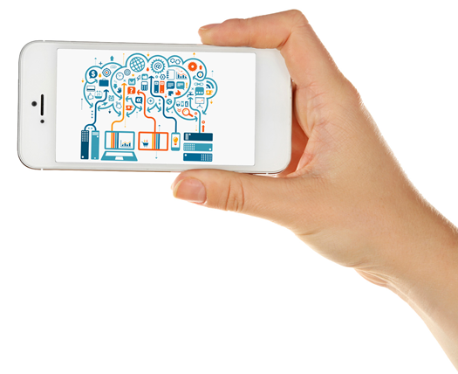
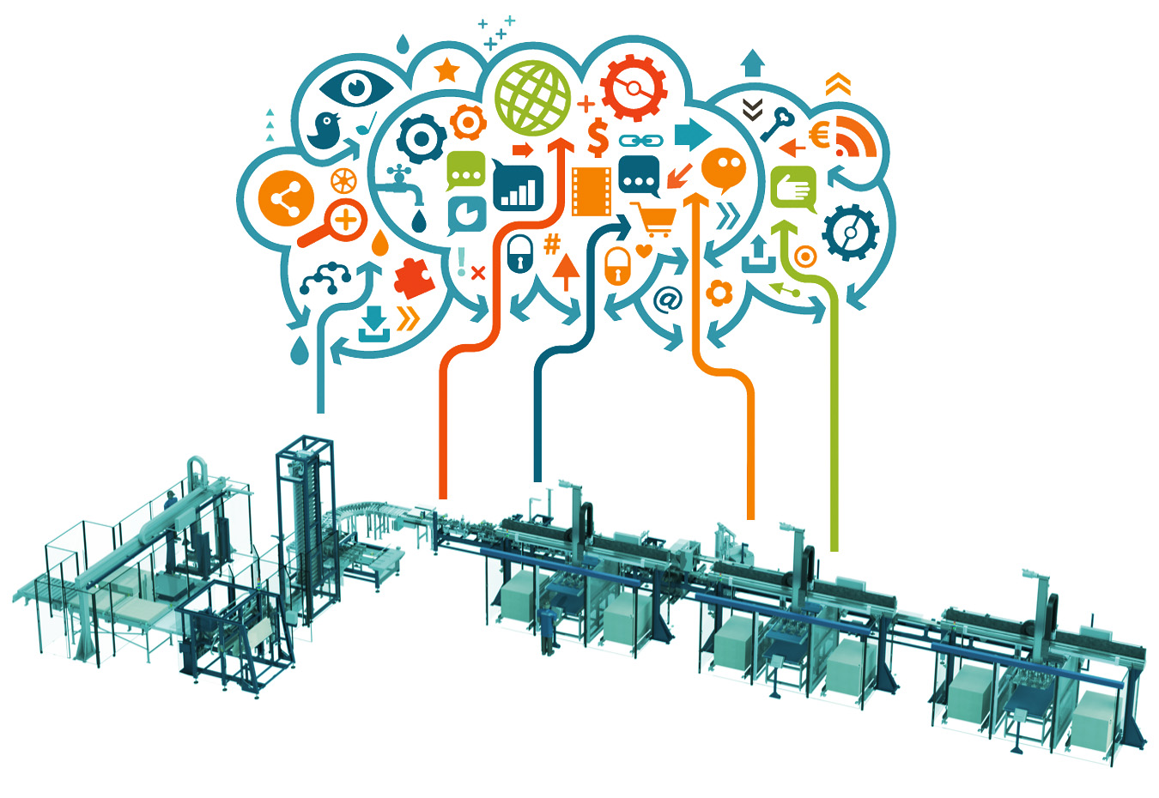

Agenda
Úvod
Internet věcí - data, analytika
a kognitivní řešenní
Software pro Internet věcí
Příklady využítí IoT

Slide 3
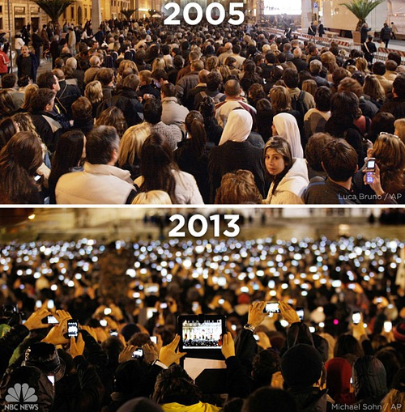
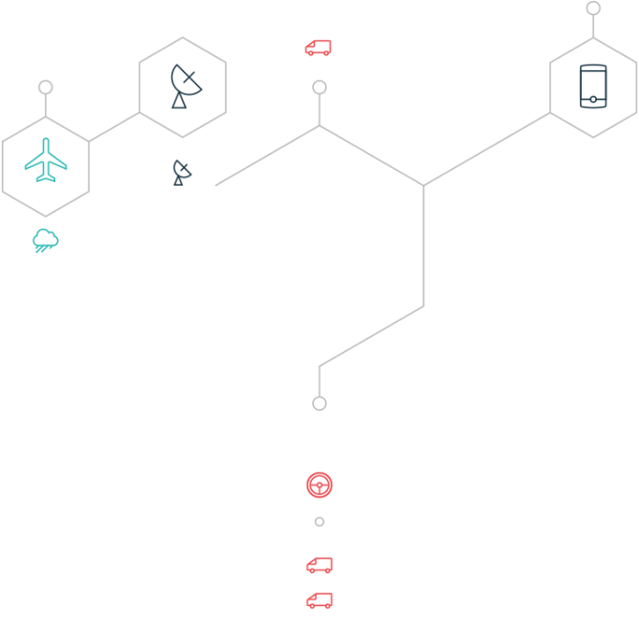
St. Peter's Square during the announcement of Pope Benedict
Notes:
Cognitive IoT is not explicitly programmed. It learns from experiences with the environment and interactions with people. It brings true machine learning to systems and processes so they can understand your goals, then integrate and analyze the relevant data to help you achieve them.

Slide 4
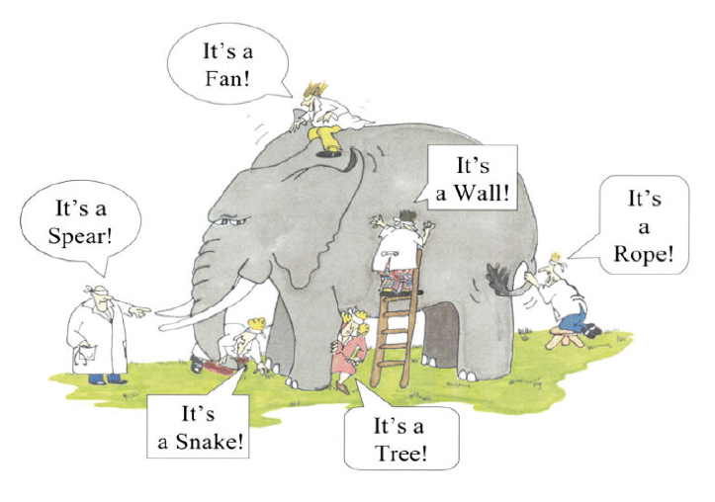

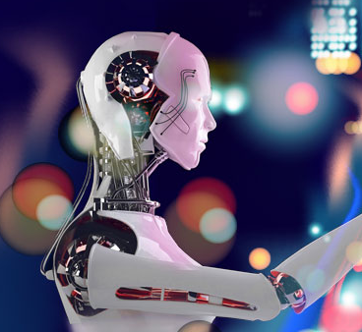
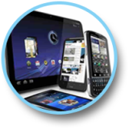
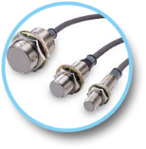
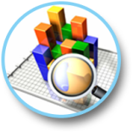

Digitální technologie nabízí panoramatickou perspektivu
Digital Technologies
„Kdo vidí slona?“
Social Media
Mobile Computing
Advanced Automation
(Robotic, 3D Printing, Drones..)
Internet of Things
Big Data &
Advanced Analytics
Cloud Computing

Slide 5
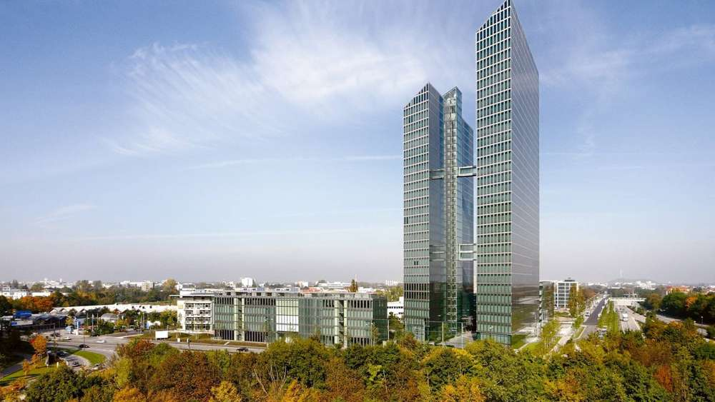
IoT HQ Munich
Talent, technologie a prostředky k budování internetu věcí ve světě se usídlily v Mnichově.
Více než 1 000 Watson IoT expertů pomáhá klientům vytvářet chytřejší řešení a kognitivní IoT.
The Highlight Towers – Munich, Germany
Notes:
There’s massive opportunity to be had, but the IoT also presents a significant data challenge as the scale, complexity and diversity of IoT data threatens to overwhelm traditional computing systems.
Traditional programmable systems are designed to handle specific scenarios and data sets. But IoT data doesn’t play by traditional rules. Images, videos, sound and machine-to-machine data all come together through the IoT. This data is then combined with data sources such as social media, weather reports and enterprise data, which provide additional context and relevancy that sharpens the value of insights.
Because of security concerns, regulatory and compliance requirements, costs, or simply the need for speed, much of this data must be processed at the network edge. IBM Watson technology represents the leading edge of cognitive computing—in fact, it’s virtually the only comprehensive cognitive computing solution. Using natural language to communicate with people, Watson technology virtually eliminates the need for users to know complex coding and have specialized IT expertise.
Cognitive computing provides the means for understanding and extending the insights gained from those massive volumes and diverse types of IoT data.
Maybe the most exciting thing about Watson technology is that it may forever shift the conversation from “What is the answer?” to “What are the possibilities?”
In the cognitive era, this is where the true competitive advantage first takes root.

Slide 6



Předvídali jsme budoucnost
V roce 2008 spustila IBM iniciativu SMART PLANET, která pomáhá utvářet základy dnešního IoT.
Nedostatečný výpočetní výkon
Chybějící algoritmy pro určitý způsob zpracování dat (nestruktovaná data
Rozdílné komunikační protokoly a vysoká cena pripojení
Konektivita řešená fyzickým kabelem
Zařízení neobsahuje sensory
Vysoká cena a nedostateně vyspělá technologie
Intelligent
Interconnected
Instrumented

Slide 7


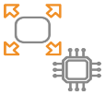





Začleňování různorodých technologií do společné sítě
IBM
Silicon
IoT Devices
Gateways
Networks
Cloud
Solution
& Applications
End-end IoT solution
IBM GTS/ IBM & Business Partners

Slide 8


IoT mění digitální pohled na svět v reálitu
Pokročilé technologie
Nové obchodní modely
Pokročilá analytika
Zlepšují se operace a snižují náklady. Možnosti vzáleného ovládání.
Cloud computing
Všudy přítomná konektivita
Vytváří se nové produkty, obchodní kanály a business modely
Product Lifecycle Management
Zlepšení spokojenosti zákazníků a inteligentní domácnosti
Zabudované sensory

Slide 9
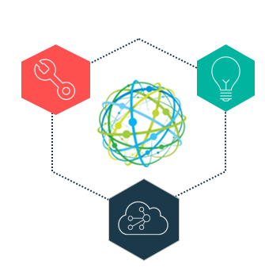
Internet věcí - data, analytika,
kognitivní řešení

Slide 10
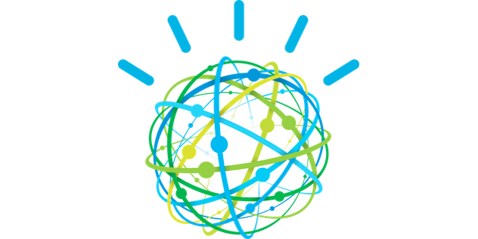
Watson API

Slide 11

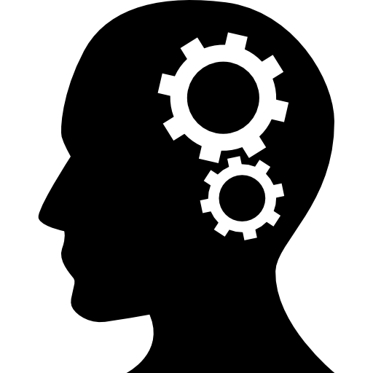


Watson IoT API umožňují snadnou integraci kognitivních a analytických aplikací do internetu věcí
Zpracování mluveného textu Umožňuje interakci pomocí přirozené lidské řeči a dialogu. | Machine Learning Automatizované zpracování dat a nepřetržité monitorování nových údajů, ze kterých se učí a zlepšuje výsledky.
Analýza textu Nachází vzájemný význam textových zrojů. Dokáže nacházet vzory a vztahy v obrovském množství textu. | Video/Image Analýza Umožňuje monitoring nestrukturovaných dat z videovysílání a obrazových snímků pro identifikaci scén a vzorů.
Notes:
Natural language Processing Example :
A technician asks about symptoms an asset is displaying. The system uses additional context including location and asset data to understand the intent of the query and returns suggestions for possible causes and repairs.
Machine Learning Example :
The system monitors incoming data from a fleet of equipment to learn both normal and abnormal conditions taking into account environment and production processes which are often unique to each piece of equipment and location.
Textual Data Example:
An asset analyst uncovers emerging problems and identifies possible root causes by analyzing the unstructured text found in customer problem reports and maintenance logs.
Video/Image Analysis
Example:
Production environments are monitored with video cameras and sensors, and a worker entering a hazardous area without the proper safety equipment is automatically notified and a safety incident is logged.

Slide 12
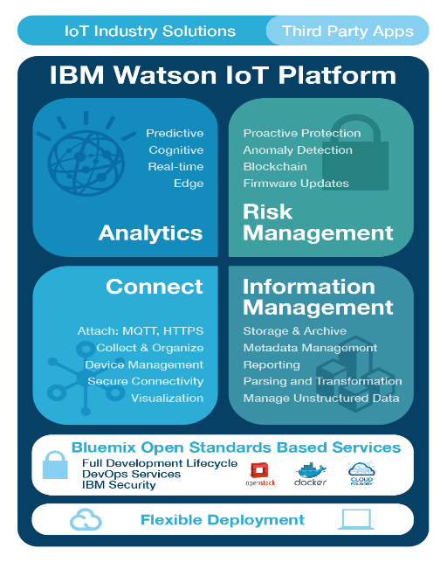
The IBM Watson IoT Platforma
Everything you need to transform with the Internet of Things
Napojení a konektivita
Připojení a správa zařízení, sítí a gateway
Informační Management
Integrace informací, strukturované a nestrukturované data ze zařízení
Pokročilá analytika
Získávání poznatků z informací v reálném čase. Prediktivní a kognitivní analytika.
Risk Management
Zajištění správných informací z důvěryhodných zdrojů, správných softwarů běžících kdykoli je to potřeba a zabezepčnení bezpečnosti od začátku do konce.

Slide 13
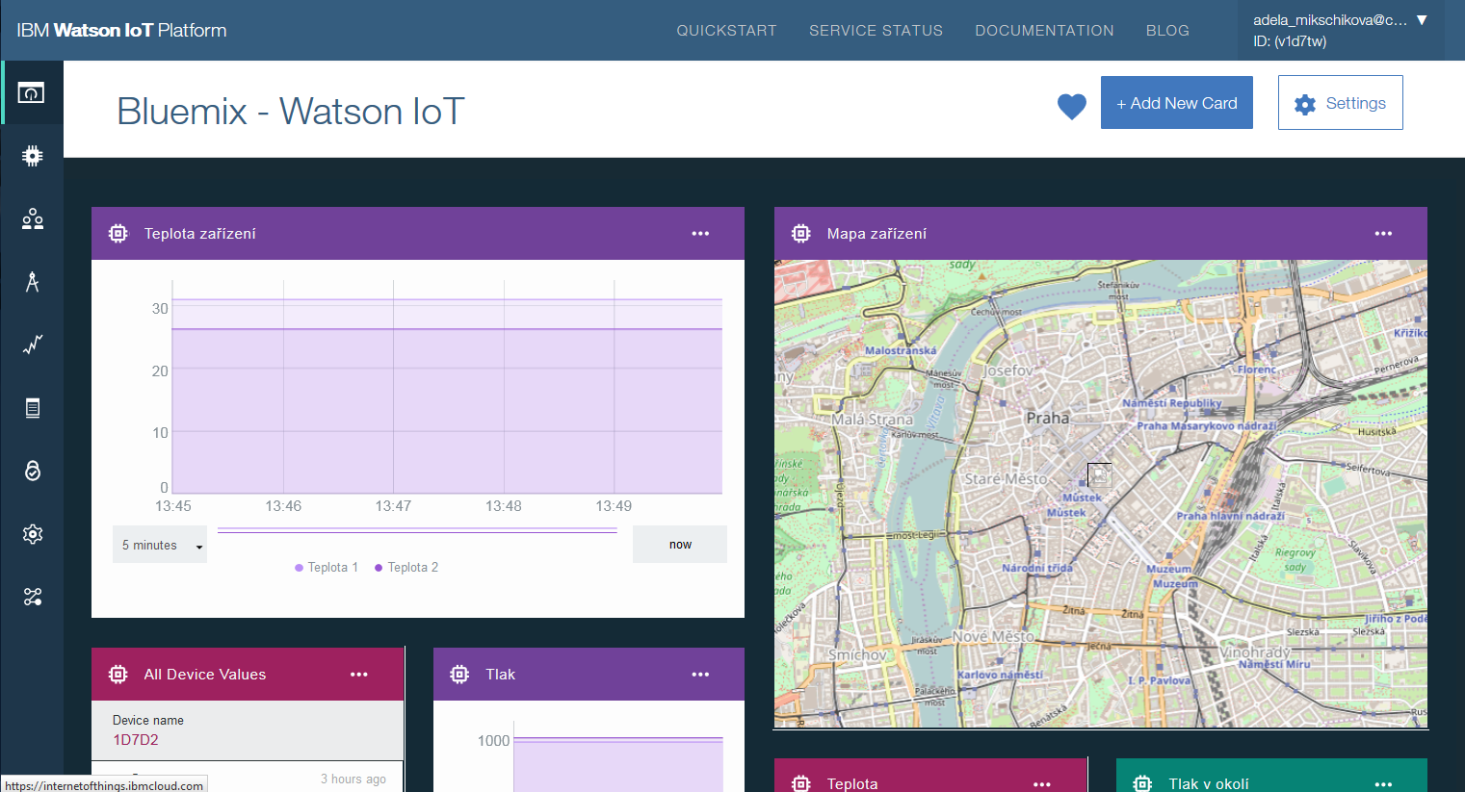

Slide 14
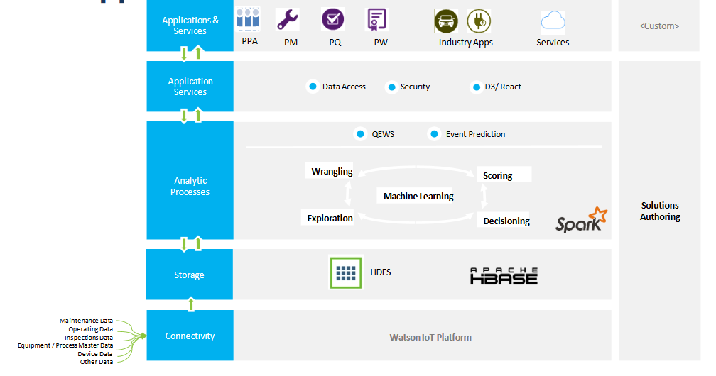
Architektura

Slide 15
Nástroje a programy pro efektivní zpracování dat z Internetu věcí

Slide 16
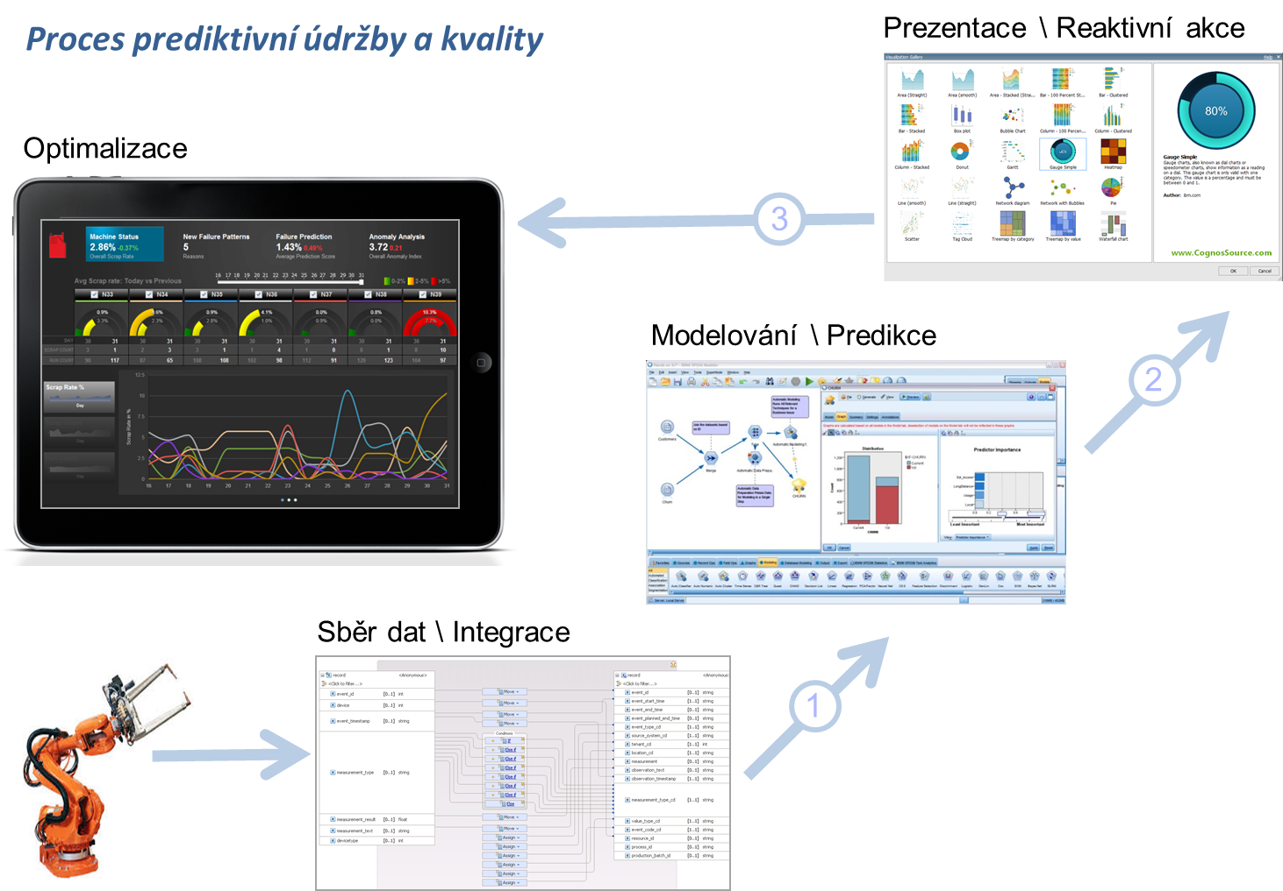
Proces prediktivní údržby a kvality

Slide 17
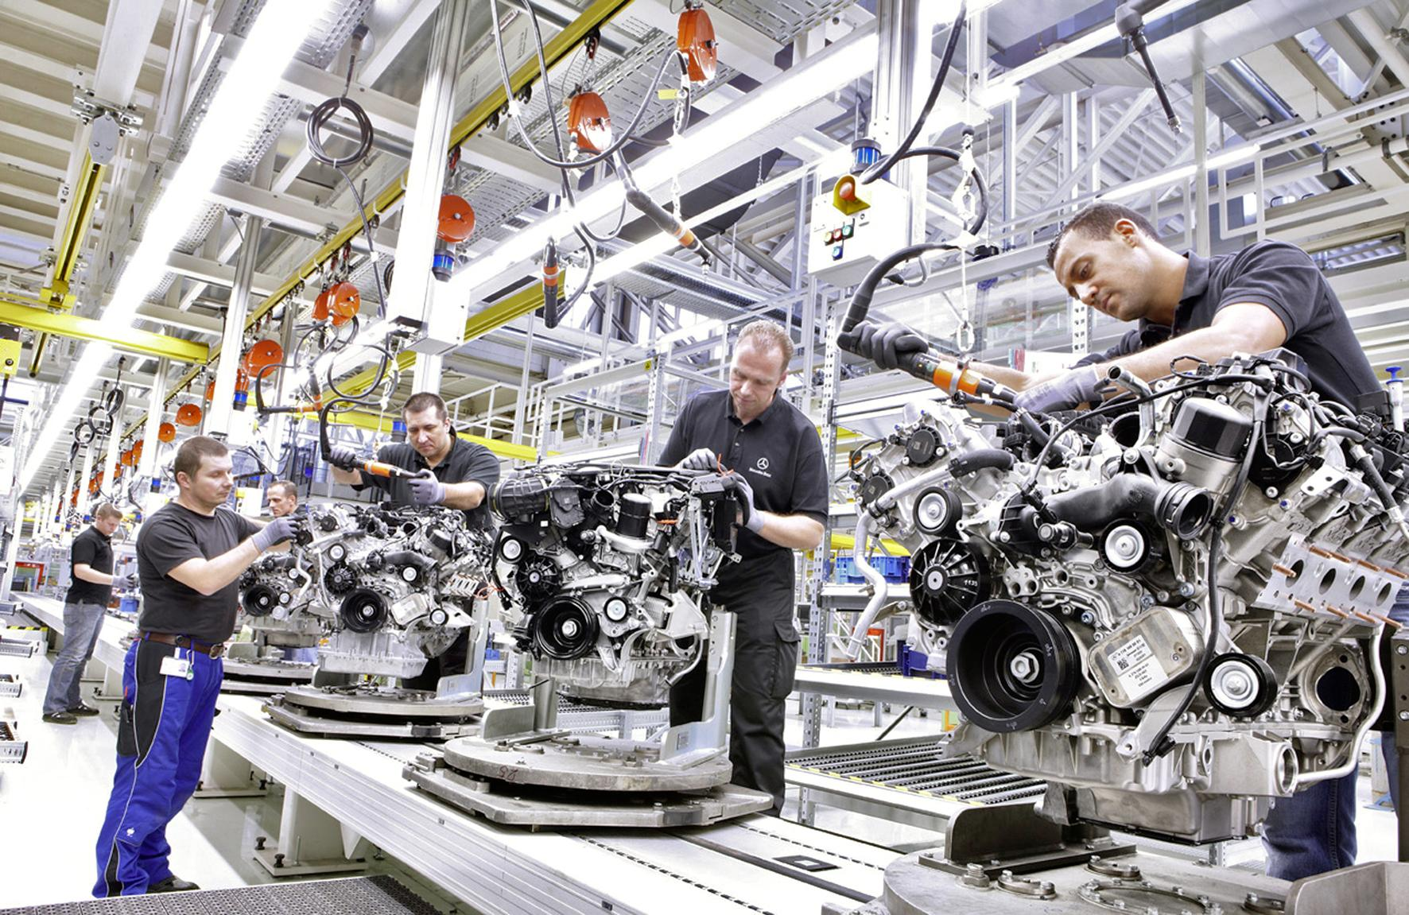
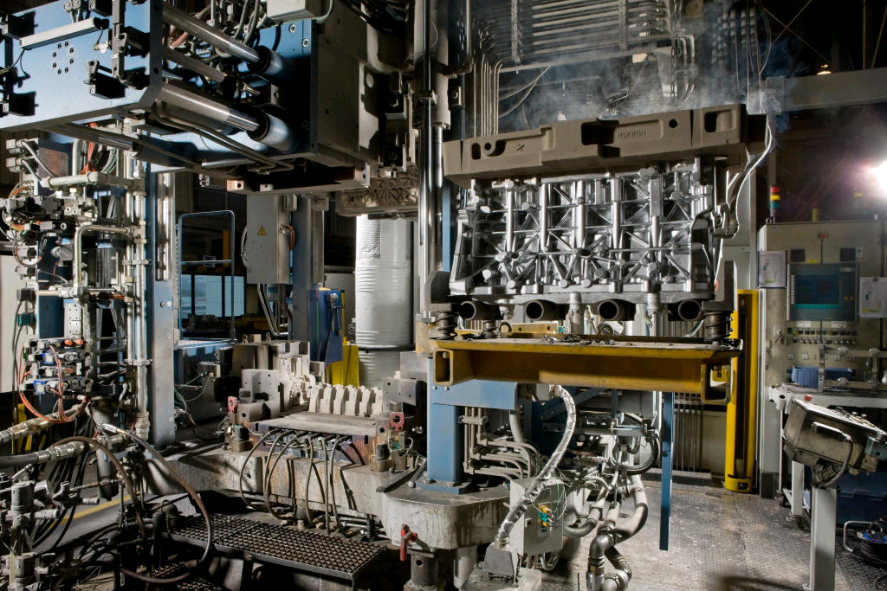
Příklady nasazení prediktivní údržby
Významný výrobce automobilů #1
Snížení zmetkovitosti o 50% během 16-ti týdnů (hlavy válců)
Významný výrobce automobilů #2
Snížení zmetkovitosti o 80% během 12-ti týdnů

Slide 18
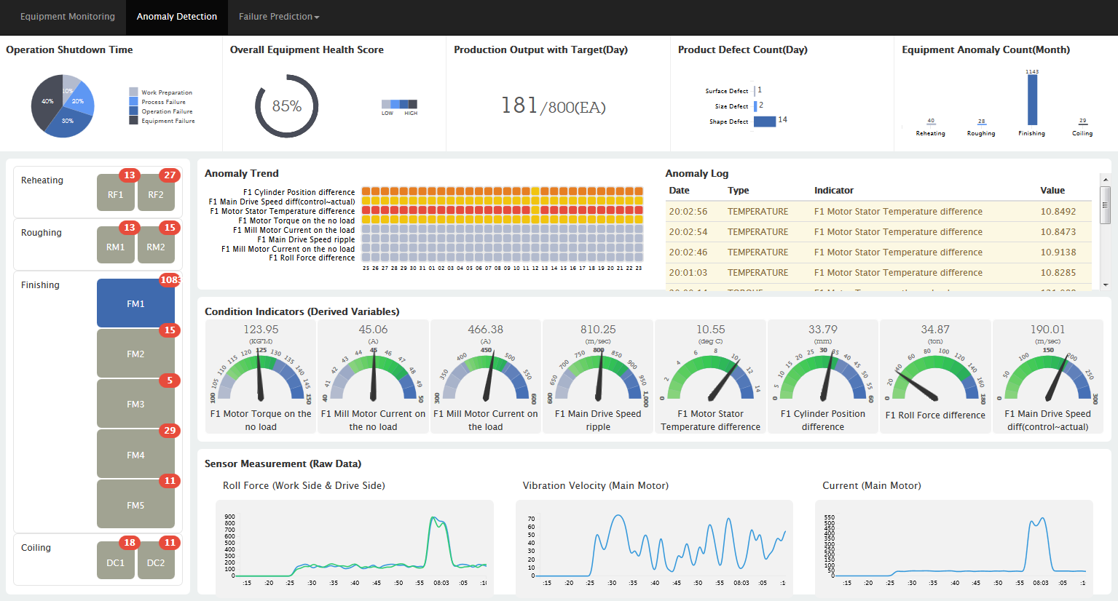

Slide 19
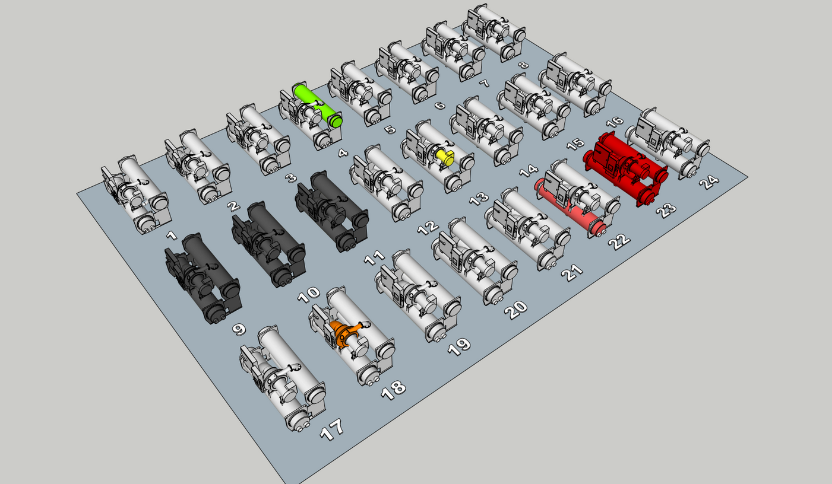

Slide 20
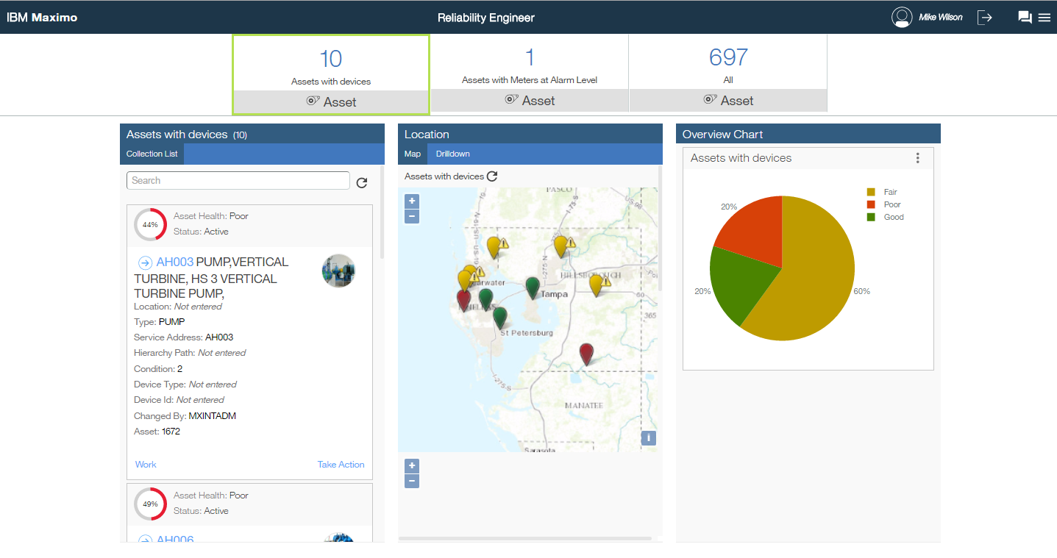
Maximo - Asset Health Insights

Slide 21
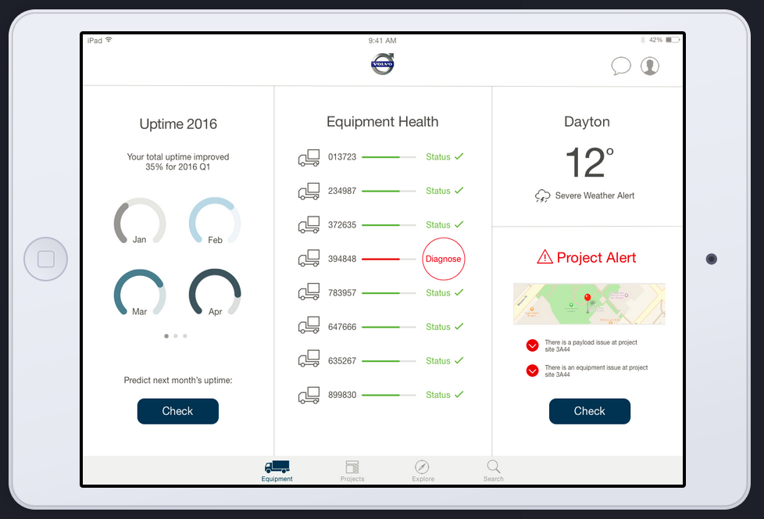

Slide 22
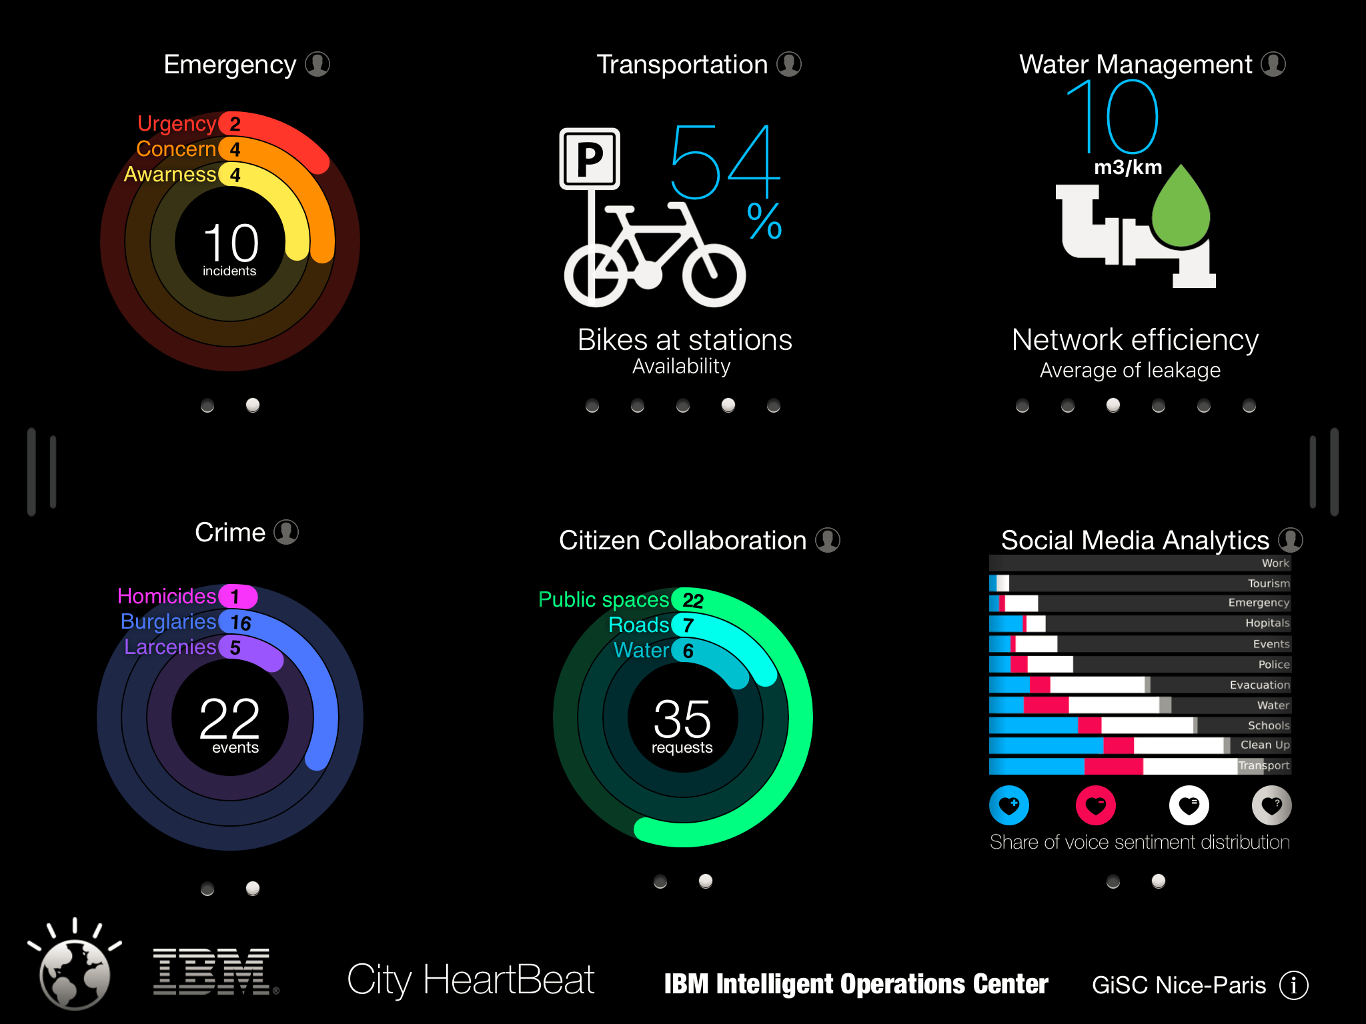

Slide 23
Příklady využítí IoT a analýzy dat

Slide 24

Kognitivní auto
Spolupráce
IBM & BMW

Slide 25
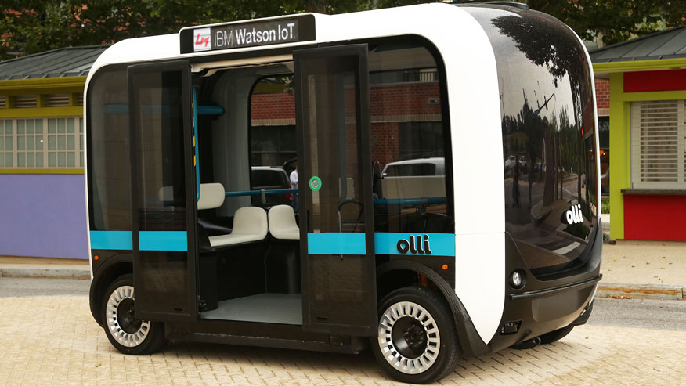
Olli is the first vehicle to utilize the cloud-based cognitive computing capability to analyze and learn from high volumes of transportation data, produced by more than 30 sensors embedded throughout the vehicle. The platform leverages four Watson developer APIs -- Speech to Text, Natural Language Classifier, Entity Extraction and Text to Speech -- to enable seamless interactions between the vehicle and passengers.
Local Motors Debuts "Olli",
the first self-driving vehicle to tap the power of IBM Watson
Notes:
https://www-03.ibm.com/press/us/en/pressrelease/49957.wss

Slide 26
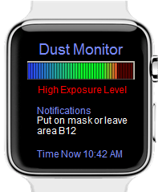
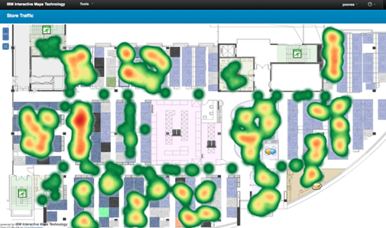
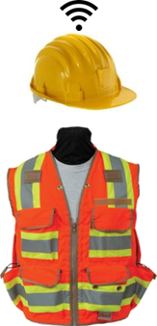
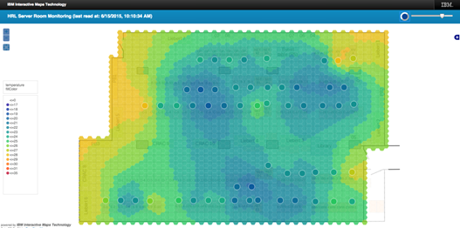
IoT v logistické společnosti
Vizualizace a analýza dat z IoT senzorů
Heat mapa: lokalizace pracovníků
Teplota / UV / znečištění

Slide 27

Watson IoT platform will collect the data for hundreds of thousands of connected devices, analyze it, and provide the required business intelligence and real time insights needed to help design better products with fewer recalls.
IoT analytics provide visibility to help understand product performance patterns under real-world conditions.
Innovation solutions are accelerated for KONE, a global
provider of building elevator and escalator technology, modernization and maintenance
Notes:
A global provider of building infrastructure selected the IBM innovative IoT solution to build their predictive maintenance capabilities enabling them to monitor trends and anticipate potential issues before they arise, helping plan maintenance schedules, improve overall efficiency, reduce downtime, and improve quality of service. IBM IoT solution will help the client constantly monitor the quality of its products and facilities as well as the performance of the equipment to help them in their continuous improvement and business excellence.
The IoT solution will connect up to 100,000 devices during the first 24months and this number is expected to increase exponentially thereafter. IoT platform will collect the data for the connected devices, analyze it, and provide the required business intelligence and real time insights needed to help the manufacturer design better products, fewer recalls, and better quality aligned with their brand identity. The solution will also provide the required visibility to help understand product performance and identify product defects or failure patterns under real-world conditions. This will help our client to predict, forecast, and most importantly provide a better experience for their end users.

Slide 28
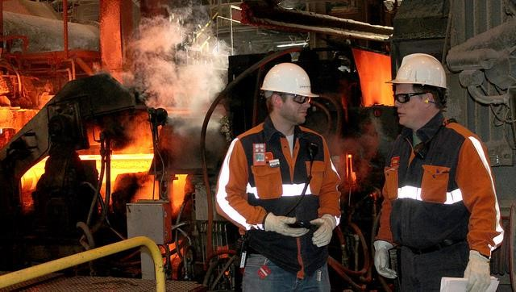
North Star BlueScope Steel
and IBM are researching
Watson IoT technology and wearable devices to pioneer
novel approaches that can help
protect workers in extreme environments.
Identification of potentially problematic conditions by collecting data from various, continually monitoring sensors
Alerts allow management to provide personalized safety guidelines to individual employees.
Notes:
In a project with IBM Research, Haifia - North Star BlueScope Steel is applying IBM Watson Internet of Things technology and wearable devices to pioneer novel approaches to help protect workers in extreme environments. North Star is piloting the IBM Employee Wellness and Safety Solution to identify potentially problematic conditions by collecting data from various sensors that continuously monitor the worker’s skin body temperature, heart rate, galvanic skin response and level of activity, correlated with sensor data for ambient temperature and humidity. The solution then alerts North Star management so they can provide personalized safety guidelines to each individual employee.

Slide 29
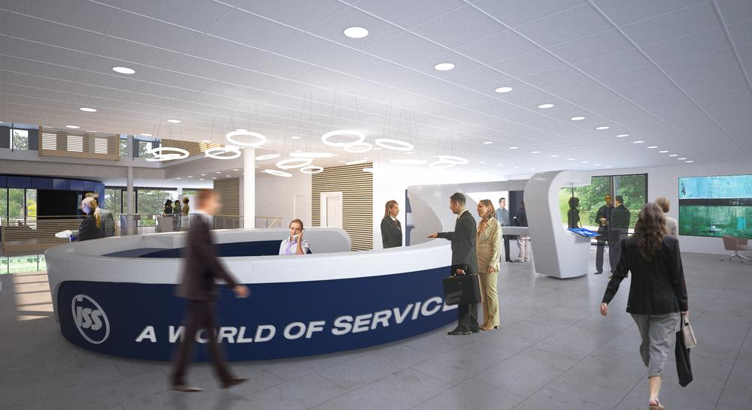
Working with IBM, ISS will integrate and analyze data from millions of devices and sensors embedded into buildings. Data will be uploaded onto IBM’s Watson IoT Platform and cognitive computing technologies will learn from this data helping ISS optimize its services and further its understanding of how people use buildings.
ISS turns to IBM Watson IoT to transform management of 25,000 buildings worldwide

Slide 30
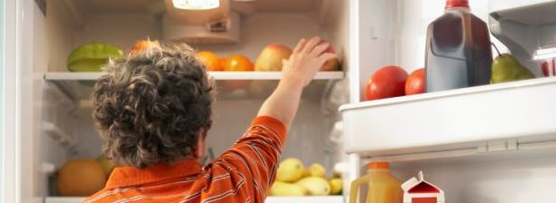
70% decrease expected in customer service call
Time – improving service levels and customer sat.
50% reduction projected in service and parts provision costs
Reduces IT costs with cloud-based hosting and solution as a service delivery
Whirlpool connected appliances provide new link from customers to warrantee services, product design and automated retail replenishment
Notes:
A comprehensive connected appliance initiative is helping one major consumer products company look forward across several major areas of their business:
When it comes to customer engagement and service, IoT can help the manufacturer connect with and provide better service to its customers. Connected appliances put customer and machine information at call center representatives’ fingertips at the start of any call. Instead of spending time determining who is calling, which machine they have and what the problem is, the representative will receive the critical information directly from the appliance's diagnostic platform, allowing for faster problem resolution. The customer experience improves with fewer, shorter and more efficient service calls, and a reduction in repeat visits.
Warranty, repair and replacement-parts costs comprise the second area in which the client can gain a sharp edge over its competition. Instead of arriving at the customer’s door essentially blind to the cause of an appliance problem and replacing multiple components in the hopes of resolving the issue on the first visit, technicians can carry the right part for the job based on the machine’s own diagnostic information provided to the call center agent. In the future, the company can use the collected sensor data and historical information to predict when a part or component is likely to fail, replacing it before the customer can experience a problem. The manufacturer expects that the cost of replacement parts may drop by at least 50 percent, helping self-fund future design improvements and breakthroughs that can help generate more revenue.
Optimized machine operations, future product design and new revenue streams make up the third area in which connected appliances can provide the manufacturer with significant advantage over its competition. For example, IoT analytics can identify analyze items like use frequency and environmental conditions to correlate patterns in service calls and continually improve product and service level offerings

Slide 31

Zajímá vás, jak bude vypadat Česká republika v roce 2022? Zveme vás na diskuzi, jak digitální transformace ovlivňuje směr technologického rozvoje ve vašem podnikání. Zkušenosti lídrů napříč obory a odborníků IBM vám pomohou osvětlit různé aspekty digitalizace a jejich reálný dopad na každodenní byznys, stejně jako nové přístupy k tomuto tématu.
Setkejte se s kolegy a experty, sdílejte zkušenosti, podělte se o váš úhel pohledu a diskutujte nad možnostmi a příležitostmi, které kognitivní technologie přinášejí.

Slide 32

Děkuji za pozornost
Dotazy?
Adéla Mikschiková
IBM Watson IoT
IBM Česká republika, spol. s r.o.
The Park
V Parku 2294/4
148 00 Praha 4 – Chodov
Česká republika
Mobile: +420 734 420 581
adela_mikschikova@cz.ibm.com

